Slide 1

Voting Application Using AWS Services
CLOUD AND SERVERLESS COMPUTING

Slide 2

WHAT IS SERVERLESS?
Serverless is a cloud computing application development and execution model that enables developers to build and run application code without provisioning or managing servers or backend infrastructure.

Slide 3
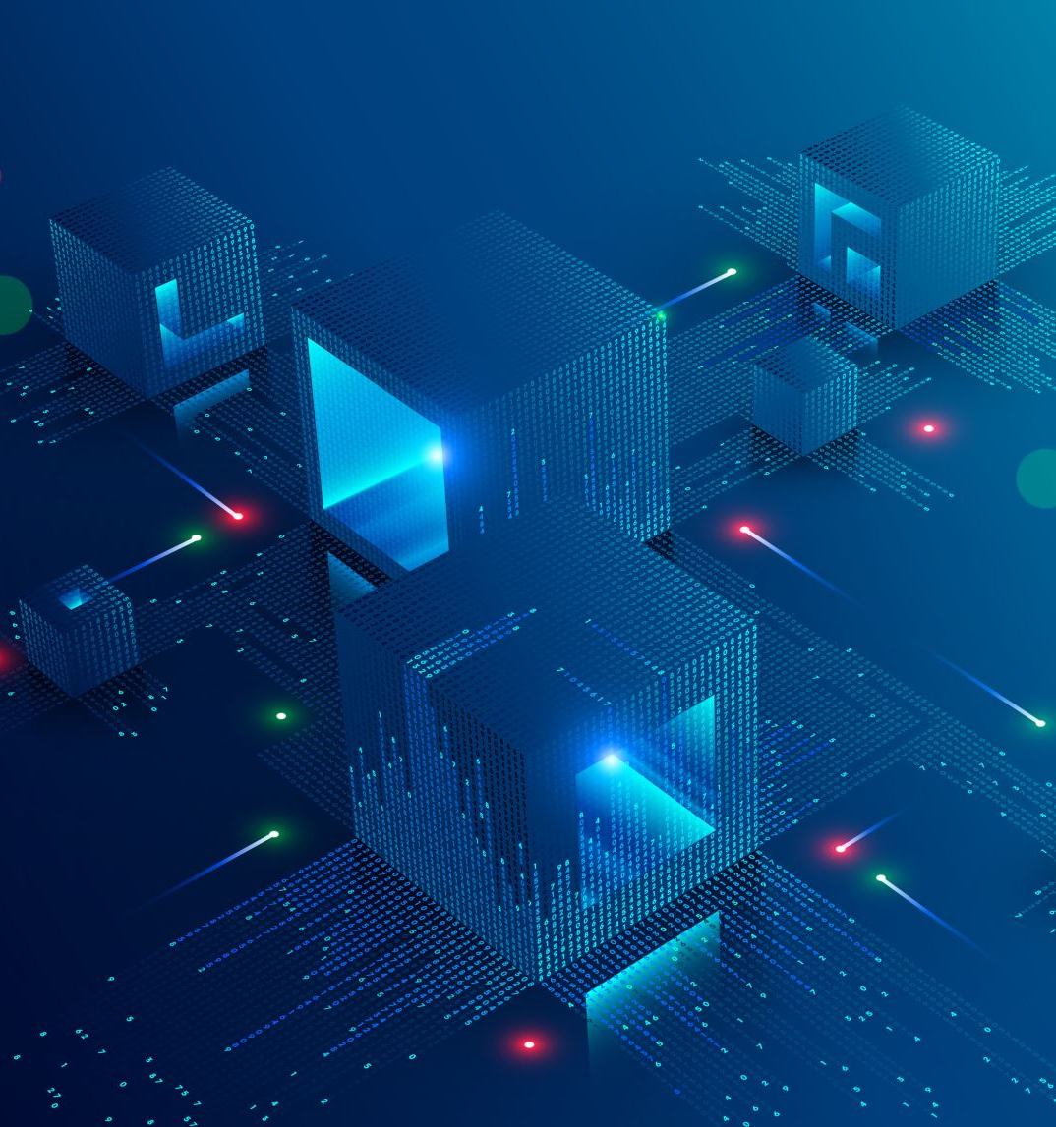
WHY SERVERLESS?
No server infrastructure Management required
Scaling is simple and precise, pay as you go
Decouples architecture keeps you agile.
What we mean by "serverless" is that you can set up your app architecture without standing up any EC2 instances. This gives you two benefits:
You don't have to pay for idle server uptime.
Your app is elastic, meaning it can automatically scale up and down with spiky traffic. So you only pay for what you use.

Slide 4
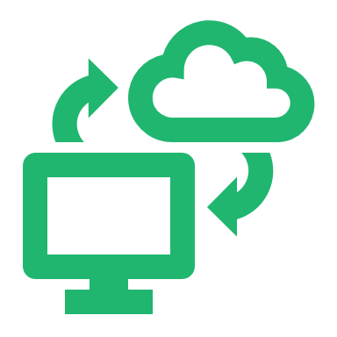
Voting Application Using AWS Services
Using an API gateway, a Lambda function, DynamoDB, and S3 to construct this voting application architecture on the AWS cloud. An AWS free tier account is the only prerequisite for this course. You don't need to have any prior knowledge of any of the AWS services.

Slide 5
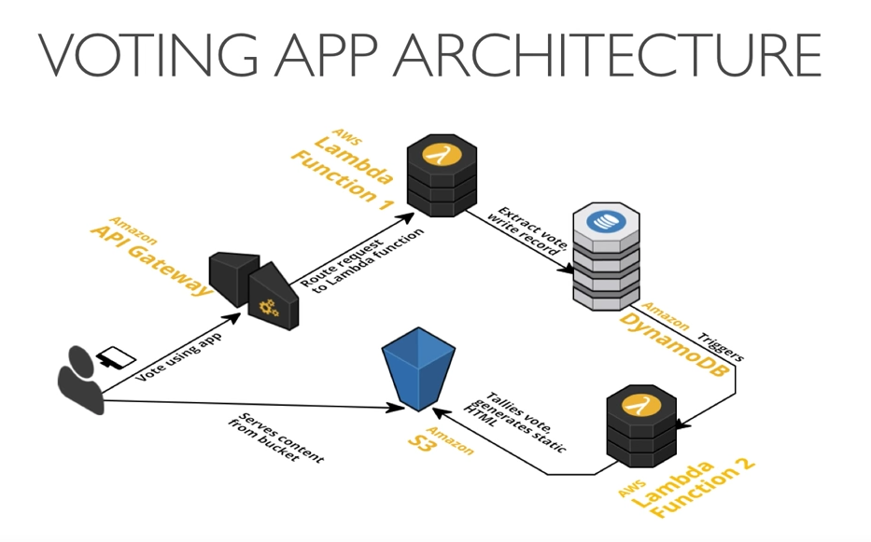
ARCHITECHTURE DIAGRAM

Slide 6

SERVICES USED:
Lambda
DynamoDB
Simple Storage Service(S3)
API Gateway

Slide 7

Lambda:
AWS Lambda is a serverless compute service that runs your code in response to events and automatically manages the underlying compute resources for you. These events may include changes in state or an update, such as a user placing an item in a shopping cart on an e-commerce website.
DynamoDB:
Amazon DynamoDB is a fully managed NoSQL database service that provides fast and predictable performance with seamless scalability. You can use Amazon DynamoDB to create a database table that can store and retrieve any amount of data and serve any level of request traffic.
Simple Storage Service(S3):
Amazon Simple Storage Service (Amazon S3) is an object storage service offering industry-leading scalability, data availability, security, and performance.
API Gateway:
API is the acronym for Application Programming Interface, which is a software intermediary that allows two applications to talk to each other.

Slide 8
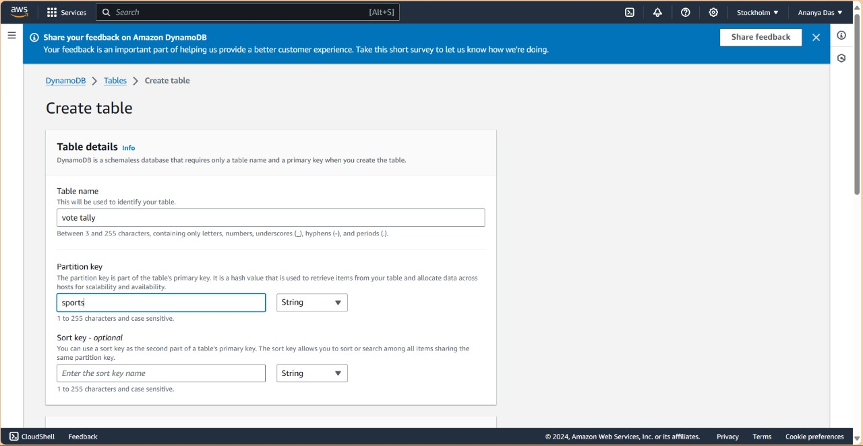
Step 1: Create a Table in AWS Dynamo DB. set up DynamoDB

Slide 9
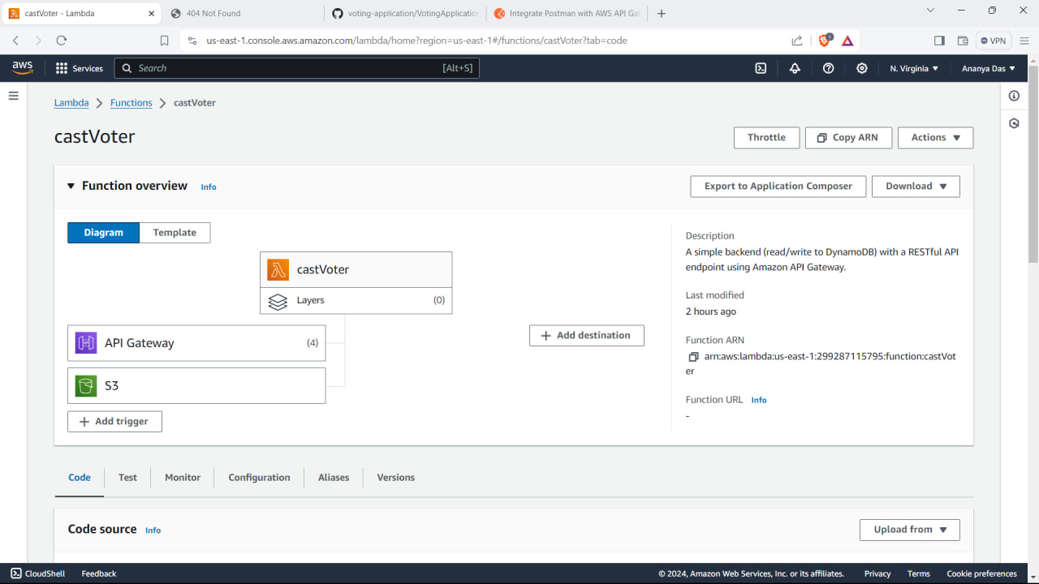
Step 2: Create Lambda Function. Set up a Lambda function

Slide 10
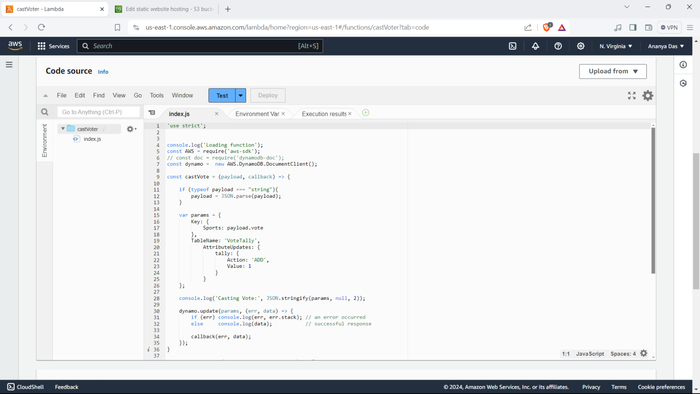

Slide 11
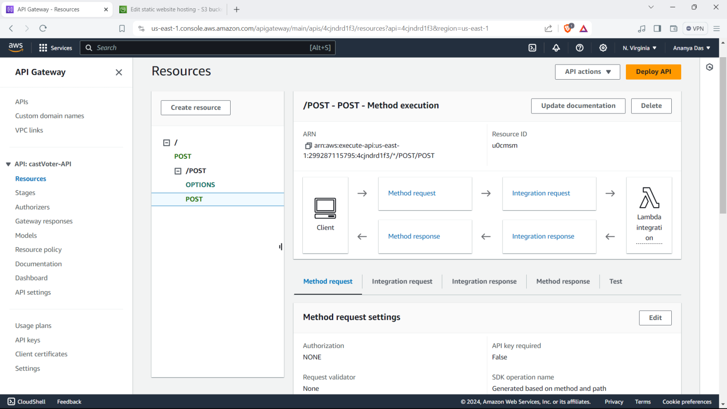
Step 3: API Gateway. Configure API gateway

Slide 12
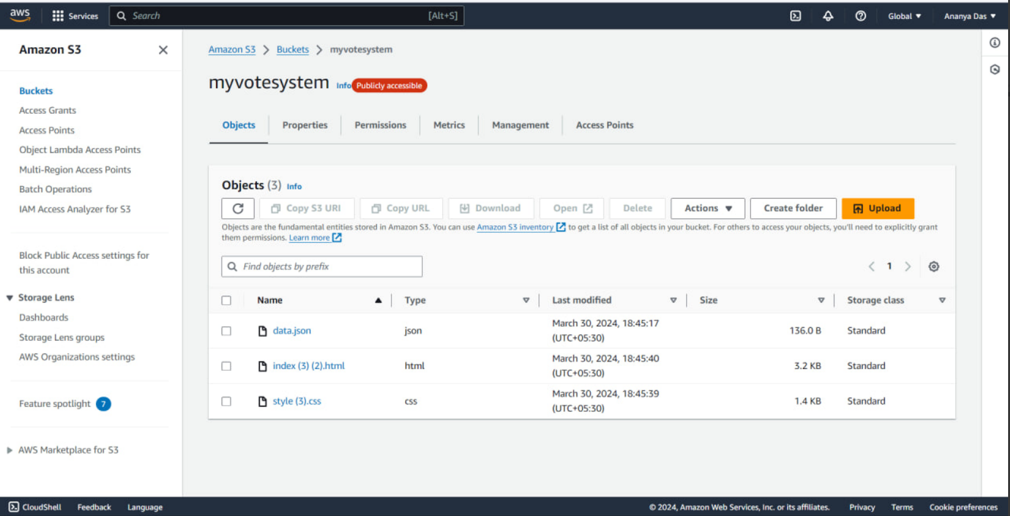
Step 4: Create an s3 bucket. Set up s3 bucket SET UP S3 BUCKET 1.Enable static website Hosting. 2.Set bucket policy to enable public access. 3. Upload HTML file.

Slide 13
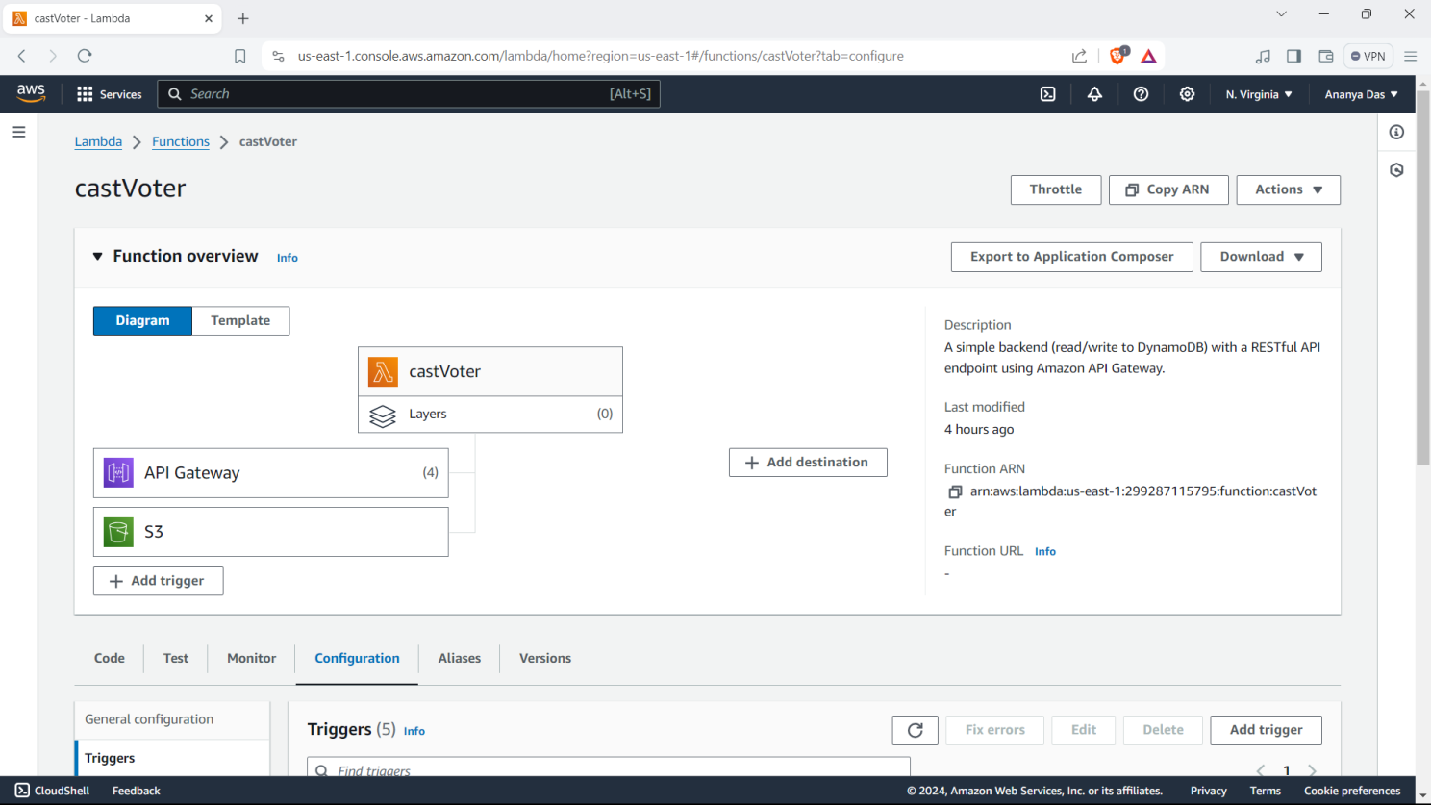
Step 5: Trigger S3 & API to Lambda

Slide 14
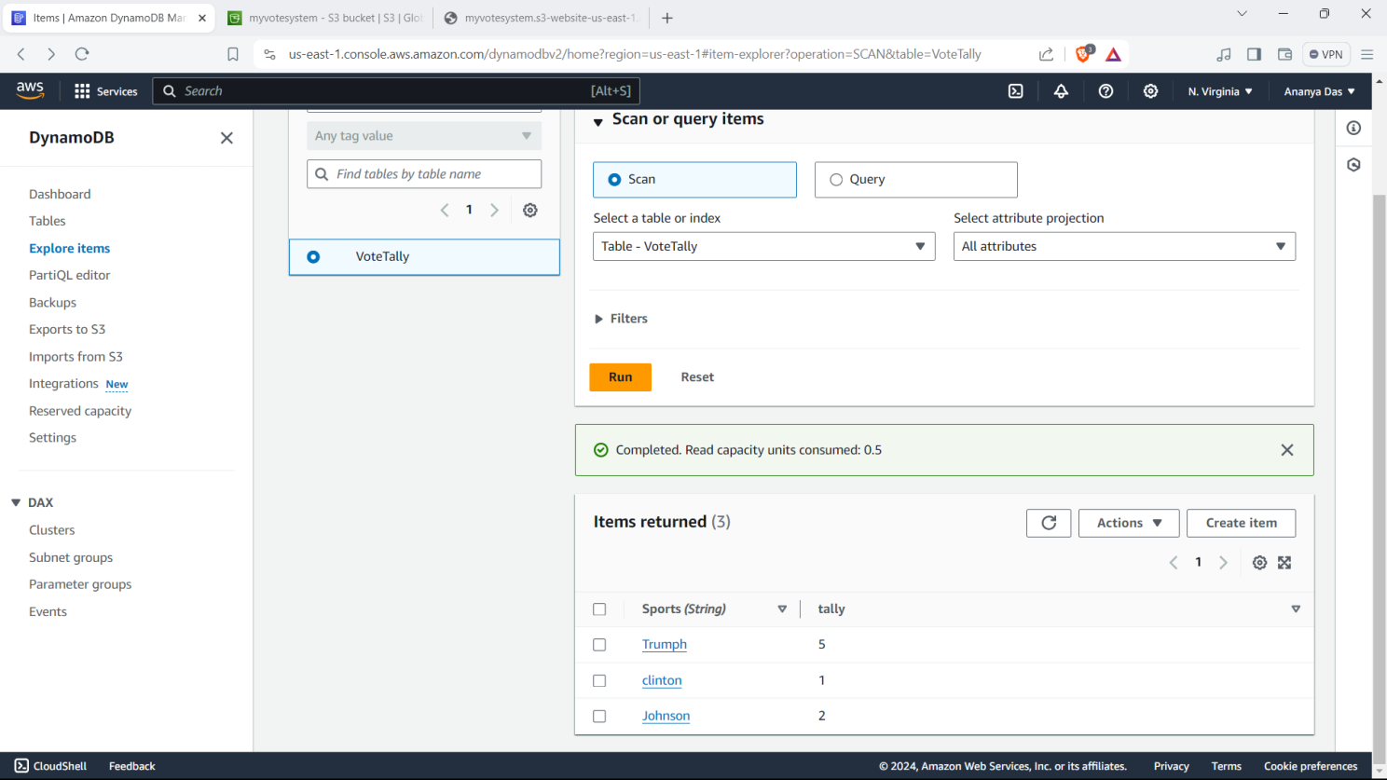
The serverless Voting Application Result:

Slide 15
tHank you

